Slide 1
Joint Programming Initiative “More Years, Better Lives”
Workshop for the participation of Non-EU Black Sea and EaP Countries in Thematic COFUND ERANETs & JPIs
13 October 2016 / Baku, Azerbaijan
VDI/VDE-IT / Peter Hahn

Slide 2
We are a service provider for innovation and technology.
Owned by VDI The Association of German Engineers (>100.000 members) and VDE
300 Engineers, Social Scientists, Economists based in Berlin
Support for analysis, funding, and organisation
of innovation and technology
Mainly for Federal German Minstries
funding
Innovation
+ Technology
analysing
organising
International Technology Cooperation
International Research and Innovation Cooperation Bi- and multilateral government initiatives; EC and global
Learning from/with the Best – sharing Innovation Knowledge Innovation system analysis and design, government based Innovation organisation and programming, Innovation management; analysis, consulting, training knowledge based economies, emerging economies, development countries

Slide 3
JPI More Years, Better Lives
Joint Programming Initiative „More Years, Better Lives“ (JPI MYBL):
JPI MYBL seeks to enhance coordination and collaboration between European and National Research Programmes related to demographic change
follows transnational multi-disciplinary approach bringing together different research programmes and researchers from various disciplines in order to make use of the potential of societal change in Europe and provide solutions for the upcoming challenges.
Mechanism: Joint Programming, Calls in 2015 / 2016 / 2017
Notes:
Joint Programming is a new approach to foster collaboration and coordination in R&D in Europe. It is a member-states driven activity. The Joint Programming Initiative (JPI) “More Years, Better Lives – The Potential and Challenges of Demographic Change” seeks to enhance coordination and collaboration between European and national research programmes related to demographic change.
Areas affected by demographic change cover a wide range of research fields and policy topics ranging from health to social welfare, education & learning, work & productivity to housing, urban & rural development and mobility. The JPI “More Years, Better Lives” therefore follows a transnational, multi-disciplinary approach bringing together different research programmes and researchers from various disciplines in order to provide solutions for the upcoming challenges and make use of the potential of societal change in Europe.

Slide 4
Countries supporting the JPI
17 Members
Austria France Poland
Belgium Germany Spain Canada Italy Sweden
Denmark Netherlands Switzerland
Finland Norway UK
Israel Slovenia

Slide 5
Aims of the JPI MYBL
Exploration and understanding of Demographic Change through a cross-disciplinary and holistic approach (Researcher level research outcomes targeted)
Joint Programming/Alignment of national/regional and EU programmes and activities (Joint/coordinated research policies and strategies to be elaborated)
Implementation through joint activities (ERA-NET like calls for transnational research projects and similar activities realized – “fast track” activities)
Public Engagement

Slide 6
(Joint ) Strategic Research Agenda
4 Research Domains
Quality of Life, Health and Wellbeing
Economic and Social Production
Governance and Institutions
Sustainable Welfare
11 research topics deriving
from these domains are
transferred into call topics
http://www.jp-demographic.eu/about-us/strategic-research-agenda-sra/

Slide 7
(Joint) Strategic Research Agenda
11 Research Topics
Quality of life, wellbeing and health
Learning for later life
Social and economic production
Participation
Ageing and place
A new labour market
Integrating policy
Inclusion and equity
Welfare models
Technology for living
Research infrastructure

Slide 8
Joint Transnational CALLS 2015-2017
2015: Extended Working Life and its Interaction with Health, Wellbeing and beyond
Funding ca. 8 M €, 11 countries> 5.404.108 € used from virtual common pot
2016: Welfare, Wellbeing and Demographic Change: Understanding Welfare Models
Funding ca. 8 M €, 11 countries, 14 Funding Agencies
2017 Working Title: Aging and Place in a Digitising World
To be preannounced in the beginning of December 2016,
launched in mid January 2017,
submission of proposals until mid-April 2017,
beginning of projects beginning 2018
it is possible to join the MYBL Call 2017 as a funder/funding agency without being a member of JPI MYBL! If you are interested to take part, please contact annette.angermann@vdivde-it.de or the secretariat of JPI MYBL (jpimybl@zonmw.nl) for further information.
/
http://www.jp-demographic.eu/calls

Slide 9
JPI MYBL Conference 2016
Health, Ageing and Migration: new patterns of demographic change
Past work and future challenges of the JPI MYBL
1st & 2nd December 2016 in Rome
discussion of topics and show case of funded projects of the first call 2015 “Extended working life and its Interaction with Health, Wellbeing and beyond” and the second call 2016 “Welfare, Wellbeing and Demographic Change: Understanding Welfare Models”
parallel sessions
challenges presented by migration
health and welfare models in a changing Europe / world
health trends and ageing population
JPI Conference is open to interested participants, for more information: http://www.jp-demographic.eu/news/jpi-mybl-conference/

Slide 10
Governance and operation of the JPI MYBL
Governance:
General Assembly - Delegates from 17 Member States
Steering Committee - Chair dr. Edvard Beem, Members Prof. Yves Joannette, François Héran and Tove Hammarberg
Scientific Advisory Board - 22 scientists representing diverse disciplines
Societal Advisory Board - 15 members from European stakeholder organizations
Secretariat:
For the operational work of MYBL „virtual office“ in labor division between members, (co-) financed by EC project J-Age II

Slide 11
Favorable (Pre)conditions for a Participation in MYBL
MYBL research topics are subject to national research policy and funding
Research in the subject is undertaken (or shall be undertaken) with national ressources
Openess to international cooperation (sharing of national political goals, cooperation of researchers in th eEuropean and global Research Area, sharing of results etc)
(Capacity to contribute to the activities of the JPI MYBL (ministry-level and/or agency level and/or researcher level)).

Slide 12
Modes of participation (III) – (Complete) Membership
The JPI MYBL …
is a bottom-up initiative that depends on voluntary contributions from its members.
is open to any interested Member State (MS), Associated State (AS) to the EU or Third Countries.
os working in varying groups: It is not obligatory that the members participate in all joint actions. Each member can actively participate in those activities identified as best fitting into the respective national strategy.
has a policy orientation : official backing from ministry or dedicated government organization is necessary.
For becoming a member …
the requesting country needs a mandate of their National Ministry or dedicated governmental organization (template provided by the Secretariat)
national representative(s) can be introduced to the General Assembly of JPI MYBL.
There is no entrance fee to be paid to be a Member of JPI.
Membership in the JPI can be terminated at the end of a calendar year.
http://www.jp-demographic.eu/about-us/how-to-become-a-member/
Notes:
The JPI MYBL is a bottom-up initiative that depends on voluntary contributions from its members. Membership is open to any interested Member State (MS), Associated State (AS) or Third Countries. It is not obligatory that the members participate in all joint actions, but each member should actively participate in those activities identified as best fitting into the respective national strategy.
The JPI will see multiple ways of partnerships and joint activities in various constellations. This basic principle shall be reflected throughout the JPI organisational set-up and functional processes.The JPI is open to any interested Member State (MS) of the European Union or Associated State (AS) to the EU or Third Country to the EU. Membership in the JPI can be terminated at the end of a calendar year, also subject by registration of the General Assembly and provided that commitments for running joint activities of the specific member are ensured.
There is no entrance fee to be paid to be a Member of JPI.

Slide 13
Potential Modes of participation (II) – Active Participation without Membership
A Join the group that is organising the call and funding the national research groups
join MYBL Call (e.g. 2017) as a funding organisation without being a member of JPI MYBL
➔ contact annette.angermann@vdivde-it.de or the secretariat of JPI MYBL (jpimybl@zonmw.nl) for further information.
And/or
B Participation in research projects
Research groups from countries outside MYBL and the call group may join research consortia that apply for funding in MYBL transnational calls, if…
they are able to secure their own funding. Such Participants should state in advance the source of funding for their part in the project.
the majority of participant groups in a consortium are eligible to be funded by the funding (member) organisations/ministries participating in the call
Notes:
The JPI MYBL is a bottom-up initiative that depends on voluntary contributions from its members. Membership is open to any interested Member State (MS), Associated State (AS) or Third Countries. It is not obligatory that the members participate in all joint actions, but each member should actively participate in those activities identified as best fitting into the respective national strategy.
The JPI will see multiple ways of partnerships and joint activities in various constellations. This basic principle shall be reflected throughout the JPI organisational set-up and functional processes.The JPI is open to any interested Member State (MS) of the European Union or Associated State (AS) to the EU or Third Country to the EU. Membership in the JPI can be terminated at the end of a calendar year, also subject by registration of the General Assembly and provided that commitments for running joint activities of the specific member are ensured.
There is no entrance fee to be paid to be a Member of JPI.

Slide 14
Potential Modes of participation (I) – Get in touch and explore ....
Website:
www.jp-demographic.eu
Meet the community at the conference
(research and also policy level)
http://www.jp-demographic.eu/news/jpi-mybl-conference/
Talk to us – right here or with the secretariat:
JPI MYBL Secretariat J-AGE II / Work Package 3 Alignment & Monitoring of research programs and policy Denice Moi Thuk Shung Annette Angermann ZonMw VDI/VDE Innovation+Technik GmbH Laan van Nieuw Oost - Indië 334 Steinplatz 1
2593 CE Den Haag 10623 Berlin
Netherlands Germany
jpimybl@zonmw.nl annette.angermann@vdivde-it.de

Slide 15
Thank you! Peter Hahn International Technology Cooperation VDI/VDE IT GmbH www.vdivde-it.de peter.hahn@vdivde-it.de +49 30 310078 276

Slide 16
What is Joint Programming?
Europe faces societal challenges which single Member States are not capable of resolving alone: climate change, energy, population ageing, …
Europe needs to elaborate a better coordinated and more coherent response. There is a need for a more strategic approach additional to existing initiatives.
Objective: increase efficiency and effectiveness of public R&D funding in Europe.
Council Conclusion from 3 Dec 2008 concerning Joint Programming of Research in Europe in Response to Major Societal Challenges

Slide 17
Current organisational development:
From Alignment to Collaboration
Joint Conference of AAL / COST / MYBL
Scheduled for February 2017 in Brussels
as JPI MYBL and AAL (Active Assisted Living Programme) are working in the same domain, but focusing on different aspects, it makes sense to collaborate and to bring the research communities of both initiatives together
the COST (European Cooperation in Science and Technology) mechanism is ideal to initiate scientific collaboration between research communities & to advance the efforts of demography related research in both AAL and JPI MYBL
informing researchers present about objectives of AAL & JPI MYBL programme and support COST offers-> to create a better understanding of common ground between AAL, COST and MYBL
Participation by invitation only. For more information please contact the JPI MYBL Secretariat.

Slide 18
Strategic Research Agenda
11 Research Topics
Quality of life, wellbeing and health
Learning for later life
Social and economic production
Participation
Ageing and place
A new labour market
Integrating policy
Inclusion and equity
Welfare models
Technology for living
Research infrastructure

Slide 19
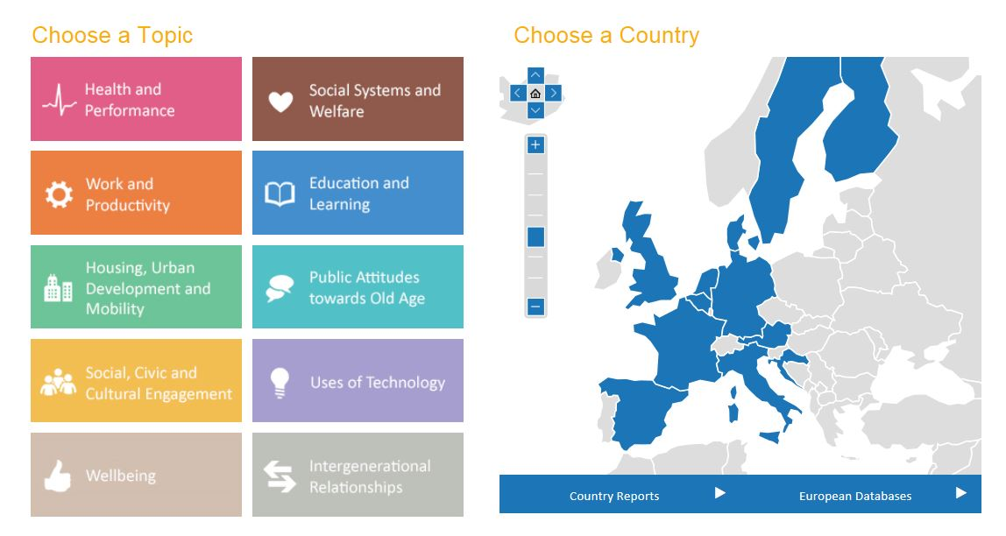
Implementation
Fast Track Activity 2013 Data Mapping www.jpi-dataproject.eu

Slide 20
Implementation
Fast Track Activity 2014 Understanding employment participation of older workers: Creating a knowledge base for future labour market challenges

Slide 21
Alignment in the ERA
Basic Research
Applied Research
Market Uptake
National Programming
European National
KIC
Healthy Living and
Active Ageing
JPI MYBL

Slide 22
Past and Current Alignment-Activities
Discussion of concepts and strategies of alignment
Research Policy Group (RPG), Working Group on Updating the SRA, Implementation Workshop
Mapping national research programs
Result: Many multi-purpose or umbrella funding programmes with some relevance; few if any examine specific impact of demography; impossible to estimate how much money might be currently committed to demographic issues
Alignment on EU-level through JPI MYBL position papers on Horizon 2020
Target: Societal Challenge 1, 2, 6, ICT Programme in LEIT
Coordination of call content with other initiatives
Notes:
Exchange of information as a minimum basis for alignment – example: tour de table at the GA-meetings, where each country reports latest activities

Slide 23
Future Alignment-Activities
European Research Area
consolidate and extend collaboration in policy networking and alignment
3rd countries
Networking with focus on USA and Latin America, China, Korea and Japan
Central and Eastern European countries
Networking
mapping exercise on funding programmes in CEE
Continue mapping of research (funding) on demographic change
Exchange on alignment experiences with other JPIs or EC-driven initiatives (AAL, etc.)
Alignment of national research programmes
Notes:
Continue mapping of research (funding) on demographic change
tool for alignment of national research programs, for connecting the conceptual framework with the data project, as source for research and policy making
Alignment of national research programmes
in Member States which do not have programmes in this field, alignment should address research programmes of leading research institutions (institutional alignment)

Slide 24
J-AGE II Project (Coordination and Support Action to JPI MYBL)
main work of J-AGE II is the EU project for the operation of its activities (but not funding of research projects)
Implementation through joint activities
→ to enhance collaboration between scientist working on ageing and Demographic Change & to reduce fragmentation through funding of transnational collaborative research-> implementation focuses on 3 joint calls (beside: Fast Track Activities like data mapping, understanding employment participation of older worker (a Fast Track on Migration is planned)
Alignment of national/regional and EU programmes and activities
→ goal of alignment is the broad implementation of JPI MYBL Strategic Research Agenda and establishment of long term agreement between member states on multiannual joint collaboration and funding under JPI MYBL
-> enhance alignment of JPI MYBL with other national research policies and programs on EU level and national level as well as on international level

Slide 25
IPotential Areas of Alignment
Research Infrastructures
International and national research infrastructures
Science Academies
Institutional alignment
Example of JPI Urban Europe Research Alliance: common vision, common projects, sharing of facilities, cooperation
Young Researchers
Summerschools, etc.
Notes:
International Bodies
Cohort Studies on Ageing
European Research Infrastructures
Survey on Health, Ageing and Retirement in Europe (SHARE)
• SHARELIFE data demonstrates that childhood health is a strong predictor of health care utilization and payments in middle and old age
• Depression is a common phenomenon in later life, yet there are crucial differences between countries. Generally women are more prone to suffer from depression than men
• Physical health and health behaviour is linked with education and socioeconomic status.
Generations and Gender Programme/Survey (GGP/GGS) – Longitudinal Study + Contextual Database
European Social Survey (part on Ageism, very strong on Wellbeing, Health, Care, Welfare Attitudes, Timing of Life)
“And at what age, approximately, would you say men reach old age?”

Slide 26
Example Project
WORKLONG – Impact of interventions and policies on prolonging working life in good health: an international study
There is lack of evidence on whether and how health interventions and policies can prolong working lives as well as the differential effects of these interventions and policies.
The overall aim of this project is to examine the bidirectional links between employment and health by quantifying the impact of health interventions on the length of paid employment, and in turn, the impact of employment and retirement policies on pathways to retirement with their effects on late-life health.
Erasmus University Medical Center, Department of Public Health, NL
London School of Economics and Political Science,
Umeå University, Sweden: Bengt Järvholm
Project duration: 03/2016 – 02/2019 (36 months)
Project costs/requested funding: 639.254 €

